Slide 1
Cyber Security Services

Slide 2



Contents
About Us 2
Introduction | Cyber Security 3
Cyber Security Services
  Process & Governance
  Compliance
  Technology Management
  Cyber Forensics & Investigations
  Support
4
Solutions
  Cyber Risk Management Strategy
  Cyber Risk Assessment & Testing
  Security Architecture & Transformation
  Incident Response
  Business Continuity Planning & Disaster Recovery
  Cyber Forensics & Investigations
7
Key Differentiators
10

Slide 3
Andersen Global
Nangia Andersen is a full member firm of Andersen Global. Andersen Global is an international association of legally separate, independent member firms with more than 1000+ global partners.
As part of Andersen Global we have reached more than 220 offices globally, having presence in more than 120 countries. Our core values are:
Best-In-Class
We aim to be the benchmark for
quality in our industry and the standard by which other firms are measured.
Stewardship
We hire the best and the brightest and we invest in
our people to ensure that legacy.
Seamless
Our firm is constructed as a global
firm. We share an interest in provid- ing the highest level of client services regardless of location.
Independence
Our platform allows us to objectively
serve as our client's advocate; the only advice and solutions we offer are those that are in the best interest of our client.
Transparency
We value open communication,
information sharing and inclusive decision making.
Nangia Andersen LLP
Provides diverse professional services and are involved in multi-disciplinary practice;
Provides assurance and advisory, cyber security, forensic services, tax, transfer pricing, management consulting and corporate law & secretarial support services;
Presence in New Delhi, Noida, Gurgaon, Pune Mumbai, Dehradun, Bengaluru and Chennai with approximately 400+ professionals and counting;
Unique portfolio of competencies to serve industry-centric clients;
Gained significant experience in working for a number of Multinational Clients, as well as for several reputed Indian clients.

Slide 4

Introduction | Cyber Security
Every business, regardless of its size, is a potential target of cyber attack. That is because every business including its vendors, partners, customers, etc has key assets criminals may seek to exploit. Sometimes that is money or financial information. At other times, it may be personal information of staff and customers, or even the business' infrastructure.
Organizations need, approach and intent towards implementation of cyber/ information security is a key to eliminate/ minimize risks to meet business goals.
Our unique business model, values and approach, combined with our trained and highly experienced workforce deliver deep insight and true value to customers seeking a partner they can trust and consult.
Our Cyber Security team is comprised of professionals having a unique skills of technology and business from diverse range of background, industry & sector experience.
Cyber threats don't always come from anonymous hackers or online criminal groups…..
Vulnerabilities can arise within your own business too.

Slide 5

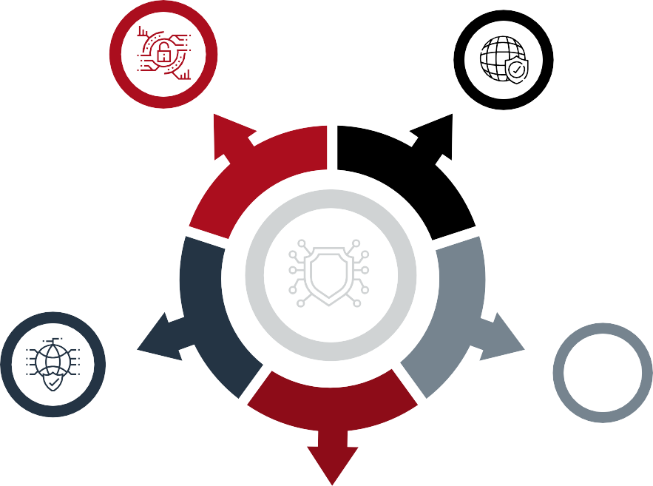
Cyber Security Services
Process & Governance
Compliance
Support
Technology Management
Cyber Forensics & Investigations

Slide 6


Cyber Security Services
1. Process & Governance
One Policy – ISO 27001, ISO 27701, NIST 800 Series, NIST CSF,
RBI Guidelines, RBI Advisory, COBIT, NESA, GDPR, CCPA, etc.
ISO 27001 certification assistance
Cyber maturity assessment
Information security policy & procedure framework design
Assessment of COBIT and operating effectiveness
Business Continuity Management
Security training and awareness
2. Compliance
Comprehensive IS for Banks – CBS, Supporting Applications, SWIFT, etc.
PCI –DSS compliance
Regulatory compliances like GDPR, CCPA
Security maturity assessment
ISAE 3402, SSAE 16 and SSAE 18 assessment
GRC compliance reviews
Third party risk management
Datacenter and DR reviews
Software compliance reviews
RBI Compliances for Banks & NBFCs
SEBI IS Compliances
IRDA Compliances
CSV Testing
Webtrust, PKI, CA Assessments
AADHAR Assessment

Slide 7




3. Technology Management
VAPT & configuration review
Application security testing
Security architecture review
Secure source code review
Red Team Assessment
Security solutions
Emerging technology security (cloud, IOT and social media
IT risk strategy & roadmap
Deployment Reviews
DevOps Security Architecture
Threat monitoring & management
Anti phishing & anti malware monitoring
Cyber threat intelligence
Security Operation Center
Security as a service
DDOS monitoring
OT Assessments
4. Cyber Forensics & Investigations
Imaging, Extraction, Carving & Indexing of data
Review of Analysis of data
Cyber forensic investigation and remediation
Support for arbitration & litigations
Providing testimony for examined forensic evidence
Reactive Cyber forensics
Malware identification & solutioning
5. Support
ITGC & Access Controls Reviews
SOX Controls Testing

Slide 8








Solutions
01.
02.
03.
Cyber Risk Management Strategy
Cyber Risk Assessment & Testing
Security Architecture & Transformation
04.
05.
06.
Incident Response
Business Continuity Planning & Disaster Recovery
Cyber Forensics & Investigations

Slide 9

1
Cyber Risk Management Strategy
One Policy ISO 27001, ISO 27701, NIST 800
Series, NIST CSF, RBI Guidelines, RBI Advisory, COBIT, etc.
ISO 27001 certification assistance
Cyber maturity assessment
Information security policy & procedure framework design
Assessment of COBIT and operating effectiveness
Security training and awareness
2
Cyber Risk Assessment & Testing
Comprehensive IS for Banks CBS,
Supporting Applications, SWIFT, etc.
PCI DSS compliance
Regulatory compliances like GDPR
Security maturity assessment
ISAE 3402, SSAE 16 and SSAE 18 assessment
GRC compliance reviews
Third party risk management
Datacenter and DR reviews
Software compliance reviews
RBI Compliances for Banks & NBFCs
SEBI IS Compliances
IRDA Compliances
CSV Testing
Web trust, PKI, CA Assessments
AADHAR Assessment
VAPT & configuration review
Application security testing
Security architecture review
Secure source code review
Red team assessment

Slide 10

13
Security Architecture & Transformation
15
Business Continuity Planning & Disaster Recovery
Security solutions
Emerging technology security (cloud, IOT and social media)
IT risk strategy & roadmap
Deployment Reviews
DevOps Security Architecture
Threat monitoring & management
Anti phishing & anti malware monitoring
Cyber threat intelligence
Security Operation Center
Security as a service
DDOS monitoring
SCADA/ OT Assessments
Develop and test business continuity and disaster recovery plan
Business Process Review
Business Impact Analysis
Risk Assessment
Recovery Time Objective
Recovery Point Objective
Assessing business requirements
Solutions to setup the state of art DC and DR sites
Project management
14
Incident Response
61
Cyber Forensics & Investigations
Review incident response plan
Develop and test incident response plan
Understanding processes
Rapid response to Incident
Immediate identification of cause
Support in implementing remediations
Security solutions
Help in preparing response to regulators
Detection and Reporting
Triage and Analysis
Containment & Neutralization
Post incident
Solution to automate the incident management

Slide 11
Key Differentiators
1
2
Blend of strategy, experience, design and technology expertise to support our clients.
Tailored solution for customers with unique business operations
3
4
Risk based actionable across Cyber Security spectrum
Trained, qualified & certified professionals with wide exposure across industries & geographies

Slide 12


Our Locations
NOIDA
(Delhi NCR - Corporate Office) A-109, Sector 136, Noida - 201304
T: +91 120 5123000
DELHI
(Registered Office) B-27, Soami Nagar,
New Delhi-110017, India T: +91 120 2598000
GURUGRAM
812-814, Tower B, Emaar Digital Greens Sector 61, Gurugram, Haryana, 122102
T: +0124-4301551/1552/1554
MUMBAI
11th Floor, B Wing, Peninsula Business Park, Ganpatrao Kadam Marg, Lower Parel, Mumbai 400013, India | T: +91 22 61737000
CHENNAI
Prestige Palladium Bayan, Level 5, 129-140, Greams Road, Thousand Lights, Chennai 600006
T: +91-44-40509200
BENGALURU
Embassy Square, #306, 3rd Floor, 148 Infantry Road
Bengaluru, Karnataka 560001
T: +91-80-2228-0999
PUNE
Office number 3, 1st Floor, Aditya Centeegra, Fergusson College Road,Next to Mantri House, Pune - 411004
DEHRADUN
First Floor, “IDA” 46 E. C. Road, Dehradun – 248001, Uttarakhand T: +91 135 271 6300/301/302/303
www.nangia-andersen.com | query@nangia-andersen.com

